Slide 1



Short, Unique and Mysterious

Slide 2

Q
Why is the Programming Language named so?

Slide 3
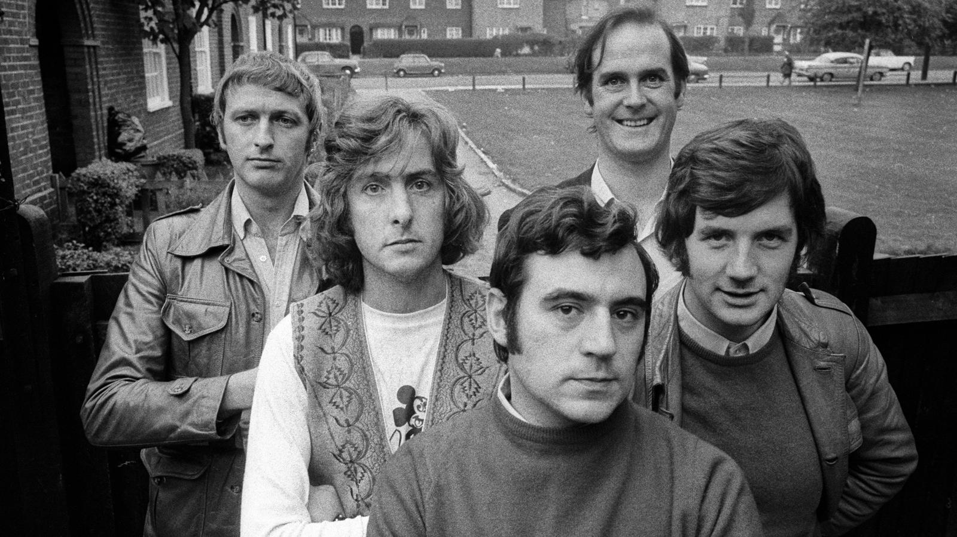
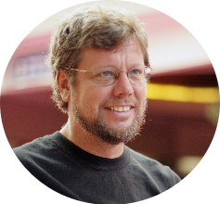
a
"
Monty Python's Flying Circus
"At the time when he began implementing Python, Guido van Rossum was also reading the published scripts from "Monty Python's Flying Circus" (a BBC comedy series from the seventies, in the unlikely case you didn't know).
It occurred to him that he needed a name that was short, unique, and slightly mysterious, so he decided to call the language Python."
"
-Charlie Cheever
(Quora User & Founder)
Guido van Rossum

Slide 4
Q
What should I know before starting?

Slide 5
a
I
Interpreted
??
PYTHON
Interactive
Beginner friendly
Object Oriented

Slide 6

a
BUILDING BLOCKS of PYTHON
PYTHON
SmallTalk
Unix shell
ABC
Modula-3
C
C++
Note - The placement of Building blocks has no relevance for dependent blocks

Slide 7


CONTENTS
Installation & Configuration
Learning Basics
>>>
Python I & S
Quick Exercise

Slide 8
Installation & Configuration
In latest LTS version of Ubuntu 16.04, Python comes installed with OS.
Make sure you've updated version before starting
To check the version of Python installed using following command on terminal
python --version
In order to update you must perform foll. steps
Open web browser and go to https://www.python.org/downloads/
Download appropriate Source code as per OS & Extract files
Run ./configure script in terminal of with respect to your extracted location, then use make & make install
$

Slide 9
Installation & Configuration
SETTING UP PATH:
Programs and other executable files can be in many directories, so operating systems provide a search path that lists the directories that the OS searches for executables.
The path is stored in an environment variable, which is a named string maintained by the operating system. This variable contains information available to the command shell and other programs.
The path variable is named as PATH in Unix or Path in Windows (Unix is case-sensitive; Windows is not).
Type in Terminal: (Ctrl + Alt + T)
export ATH="$PATH:/usr/local/bin/python" and press Enter.
$

Slide 10


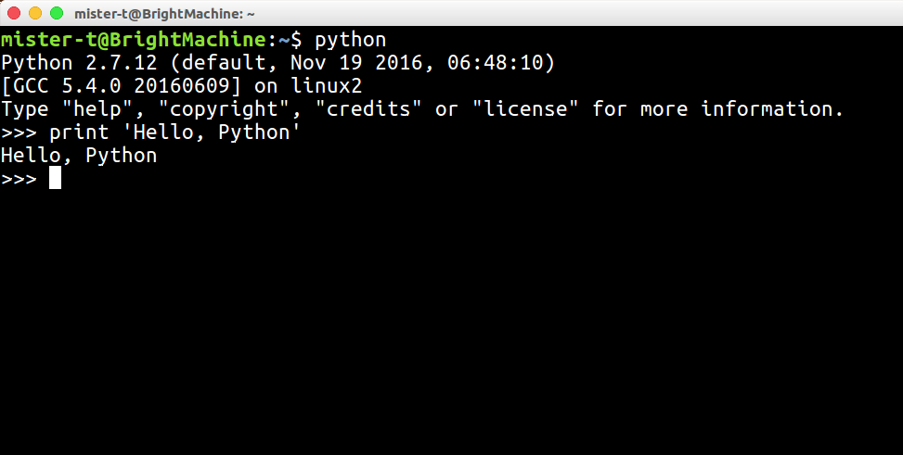
Learning Basics
RUNNING PYTHON
IDE: IDLE, PyCharm
Interpreted & Interactive Mode: Open and type in python or python3 in case you've updated
$

Slide 11
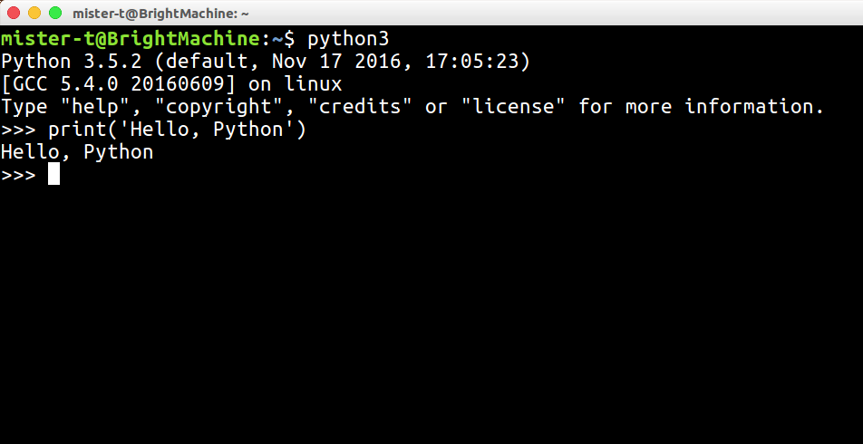
Learning Basics
There are slight differences from version to version, and are not majorly changed with respect to syntax.
Remember - Python is a Case-sensitive language

Slide 12
>>>
Python I & S
The three closed angular brackets at the beginning of every line is the Python prompt
It marks the beginning of the Interpreter
EXERCISE:
Type following in Interpreter mode of python
a = "Hello"
b = "Python"
print(a, b)
and observe the output.

Slide 13
>>>
Python I & S
The Interpreter mode is easy and fast enough to execute line by line, but when it comes to one monolithic programming logic we go for writing Scripts.
It is similar the way we have been writing programs for C++ & Java.
#!/usr/lib/python3.5
a = 3
b = 7
print("Multiplication of 3 * 7 = ",a * b)
multiply.py

Slide 14
>>>
Python I & S
DATA TYPES:
Numbers/Integers......(0, -1, 34, 2.1, 10065e, 10222.122254L)
String.....................................(Hello world, Sum=, Enter value)
List.........................................................(grocery list, to do list)
Dictionary..................................(a:First Letter,b:Second Letter)
Tuple.............................................(List of Marks, Race records)

Slide 15
>>>
Python I & S
ASSIGNING VALUES:
A well understood paradigm in programming of assigning values to variables is much easier in Python
Foll. the given examples-
  Name = "Lord Snow"
  Year = 2017
  Birth = Death = "Undecided"
Strings needs to be written in either Single Quotes (' ') or Double Quotes (" ") to save it as a string
Number can be assigned plainly, & can be integer or float
Multiple assignments is easily possible in transitive manner
EXERCISE:
Type following in Script Mode
uname = first_name = "Emily"
pass = "password"
print("Your Credentials are UN",uname," PW",pass)
and execute the script

Slide 16
>>>
Python I & S
RESERVED WORDS:
and | exec | not
assert | finally | or
break | for | pass
class | from | print
continue | global | raise
def | if | return
del | import | try
elif | in | while
else | is | with
except | lambda | yield

Slide 17
>>>
Python I & S
IDENTIFIERS:
Class names - All classname's must initiate with Uppercase letters.
  Eg- Add, Round, Animate
Private - A private identifier must begin with an underscore "_".
  Eg - _varA, _varB
Strongly Private - A Strongly private identier initiates with double underscores "__".
  Eg - __varC, __Add
Special Names - There exists q set of names which initiate and end with doube underscores denoting it as a name with special meaning.
  Eg - __init__

Slide 18
Quick Exercise
Try the following in Python Interpreter:
INTEGERS
>>> 5+4 >>> 5-4
9 1
>>> 5*4 >>> 5**4
20 625
>>> 5/4 >>> -5/4
1.25 -1.25
>>> 5%4 >>> -5%4
1 3
Exponential operation: 5⁴
Integer division rounds down
remainder (mod) division returns 0 or positive

Slide 19
Quick Exercise
>>> 65536*65536 >>> 4294967296*4294967296
65536 18446744073709551616L
No inherent limit to Python's integer arithmetic:
can keep going until we run out of memory

Slide 20
Quick Exercise
FLOATING POINT
>>> 1.0 Floating point number
1.0 (& usual issues with them)
>>> 1/2
0.5 Ok
>>> 1/4
0.25 Ok
>>> 0.1
0.10000000000000001 Issues with representation in base 2 (Altough it has been covered from Python 2.7 onwards)

Slide 21
Quick Exercise
TESTING ACCURACY
>>> 65536.0*65536.0
4294967296.0
>>> 4294967296.0*4294967296.0
1.8446744073709552e+19
Accuracy of upto 16 places after Decimal
>>> 1.157920892373162e+77*1.157920892373162e+77
1.3407807929942597e+154
>>> 1.3407807929942597e+154 * 1.3407807929942597e+154
inf

Slide 22

Quick Exercise
MACHINE EPSILON
>>> 1.0 + 1.0e-16 Too small to make
1.0 a difference
>>> 1.0 + 2.0e-16 Large enough, hence
1.0000000000000002 more precision
>>> 1.0 + 1.1e-16
1.0
>>> 1.0 + 1.9e-16
1.0000000000000002
'e' - Means
9.0122222900391 × 10⁻⁵

Slide 23

To Be Resumed after Break

